Slide 1










The Perinatal-Neonatal Quality Improvement Network of Massachusetts
Implementing the AIM Perinatal Mental Health Conditions Bundle in MA
Organization: Postpartum Support International
October 15, 2024

Slide 2

Agenda
12:00-12:05 Welcome & PNQIN Announcements
12:05-12:45 Organization Presentation
12:45-12:50 PMHC Bundle Pearls
12:50-1:00 Discussion, Q&A
WELCOME!
Please type your name and institution into the chat​.
Optional share: What is your favorite Halloween movie?
Please mute yourselves when not speaking.
Feel free to type your questions into the chat during the webinar​.
We will record this session and upload the recording and webinar slides to our website afterwards!

Slide 3
AGENDA
12:00-12:05
Welcome & PNQIN Announcements
Kali Vitek
12:05-12:45
Postpartum Support International
Kriti Lodha & Amy Colozzo
12:45-12:50
PMHC Bundle Pearls
Tiffany Moore Simas, MD
12:50-1:00
Discussion, Q&A
All

Slide 4
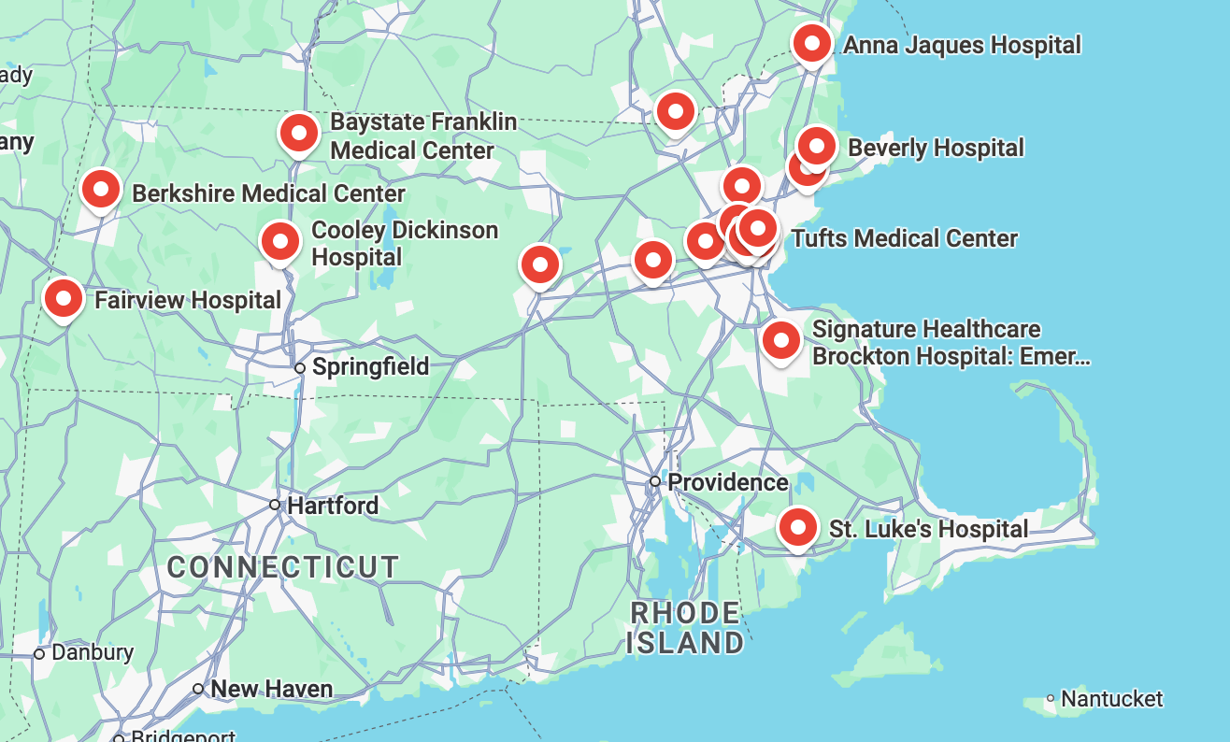
PMHC BUNDLE: PARTICIPATING HOSPITALS
Anna Jaques Hospital
Baystate Franklin Medical Center
Berkshire Medical Center
Beth Israel Deaconess Medical Center
Beverly Hospital
Brigham and Women's Hospital
Boston Medical Center
Cooley Dickinson Hospital
Fairview Hospital
Lowell General Hospital
Massachusetts General Hospital
MetroWest Medical Center
Mount Auburn Hospital
Newton-Wellesley Hospital
Salem Hospital
Signature Healthcare Brockton Hospital
17. Southcoast Charlton Memorial Hospital
18. Southcoast St. Luke’s Hospital
19. St. Elizabeth’s Medical Center
20. Tufts Medical Center
21. UMass Memorial Medical Center
22. Winchester Hospital

Slide 5

Participation Checklist
To be considered fully participating in this bundle between Sept ‘24 and Sept ’25, we ask that you complete:
Onboarding steps
Team Roster, Pre-Implementation Survey, data sharing agreement
Monthly data submission (Goal: 6 months or more)
Monthly webinar attendance (Goal: 6 months or more)
Implementation feedback survey @ 6mo and 12mo
Draft or final sustainability plan
Sharing opportunities (webinars presentation, summit posters)
Ro Iverson, Kali Vitek

Slide 6







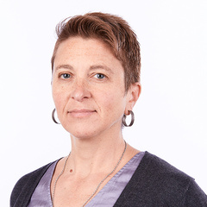
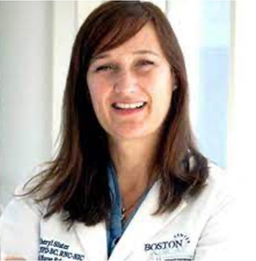














PNQIN PMHC BUNDLE WORKGROUP
Tiffany Moore Simas, MD
UMass Memorial Health
Kali Vitek, MPH​
PNQIN​
Brooke Fortin
PNQIN
Amanda Small, RN
MGH/PPD Survivor
Beth Buxton
DPH
Bonnell Glass, MN​
PNQIN/UMass
Candice Belanoff, ScD​
BUSPH
Cheryl Slater, RN
PNQIN/BMC
Elizabeth Howell, RN
UMass
Elysia Larson, ScD​
HMS/BIDMC​
Christin Price, MD​
PNQIN​
Hannah Boyner
BIDMC
Jess Gaulton, MD
FamilyWell Health
Jessie Colbert
Mass PPPD Fund
Kettie Louis, DNP
BMC
Kristie Leeman, MD
PNQIN/BCH
Kriti Lodha
PSI-MA/PPP Survivor
Julia Prentice, PhD
BLC
Jelia Frano
Deloitte/PPP Survivor
Karen Manganaro, DNP
PNQIN/BWH
Molly Fraust-Wylie
PNQIN/BIDMC
Pratiksha Yalakkishettar, MD
UMass
Ricky Seeber, MD
MGH
Shaniqua Choice
Infinity Equity Consulting
Leena Mittal, MD
MCPAP for Moms
Melissa Abell-Bardsley,
RN​, CHA​
Ron Iverson, MD
PNQIN/BMC
Uruj Haider, MD
MCPAP for Moms
Maithri Ameresekere,
MD, BMC

Slide 7

Agenda
12:00-12:05 Welcome & PNQIN Announcements
12:05-12:45 Organization Presentation
12:45-12:50 PMHC Bundle Pearls
12:50-1:00 Discussion, Q&A
Reminders & Announcements
Kali Vitek, MPH​
PNQIN​ Project Manager

Slide 8

PNQIN
Announcements

Slide 9

PNQIN 2024 Fall Summit Registration - NOW OPEN!
Summit Date: December 9, 2024 from 8:30am-4:30pm
Location (in-person): Four Points by Sheraton Norwood in Norwood, MA
Theme: Collective Community, Collaboration, and Care: Working Together to Promote the Well-Being of Birthing Families
Registration fee:
$50 for Physicians
$25 for all other care providers and professionals
Free registration available for patients/families with lived experience and students/trainees).
Registration page and agenda: https://cvent.me/9NDBrG
Space is limited to 350. Please register by December 2nd!

Slide 10

Call for Posters
For our upcoming PNQIN Fall 2024 Summit on December 9th in Norwood, MA, we are bringing back our poster sessions! We encourage hospitals and organizations planning to attend the summit share their work with other attendees via poster presentation.
We ask that the topic you share have a relation, whether directly stemming from, or similar topic to, past and/or present PNQIN projects. We also strongly suggest a focus on quality improvement.
Please submit your poster for consideration here by October 28th. Guidelines and poster template will be shared via email after this webinar.

Slide 11


Call for Publications
PNQIN has compiled relevant publications from our incredible PNQIN collaborators on our website. You can view them here. If you have any publications that you believe are relevant and should be included, please send them along!
Send citation and/or PDF of the publication to PNQINAdmin@pnqinma.org.

Slide 12
MA
Announcements

Slide 13
Apply for an Appointment to the Massachusetts Board of Registration in Midwifery (deadline: TODAY)
How to apply: Submit a letter of intent, current resume, and demographic form by email to Cristina Alonso at cristina.e.alonsolord@mass.gov
The Maternal Health Bill, signed in August 2024, established the Board of Registration in Midwifery within the Department of Public Health - a nine-member board charged with establishing regulations to govern the practice of midwifery and overseeing the licensure of midwives:
Five (5) midwives
One (1) obstetrician-gynecologist, with experience working with midwives.
One (1) maternal-fetal medicine specialist, with experience working with midwives.
One (1) certified nurse-midwife
One (1) member of the public.
The board will meet monthly, via Zoom on the 2nd of the month from 9:00 a.m. to 5:00 p.m. from January through December. Board members will serve a term of three (3) years, and upon the expiration of a term of office, a member shall continue to serve until a successor has been appointed and qualified.

Slide 14

Team Boston Climb Community Event - Hosted by Postpartum Support International & Boston Birth Village
When: Sunday, October 27th, 2024
Time: 11:00am-12:30pm
Location: 60 Stein Circle in Newton, MA
Register: https://give.postpartum.net/team/575720
Donations accepted
The Climb is the world's largest event raising funds and awareness for the mental health of new families, and is operated by Postpartum Support International (PSI).
Our goal is to connect community members, survivors, businesses, organizations, & providers to raise awareness, funds & build community around perinatal mental health.

Slide 15

Free Education
This online training series (10/19, 11/14, 12/5, 1/14) will offer critical information, resources, and discussion on Perinatal Mood and Anxiety Disorders (PMADs) and supporting birthing people and other new parents, and is geared toward a range of providers.
FREE REGISTRATION AND CEUs with an optional donation to the Mass. PPD Fund. Recordings will be available but live attendance is required for CEUs.
QUESTIONS? Please contact Asmeet Sran at asran@massppfund.org.
​
Register here!​

Slide 16

Care, Connections, and Community Webinar hosted by HHS Region 1 (Oct 29th)
This webinar will highlight programs, resources, and innovative approaches that improve behavioral health of pregnant and postpartum people in Connecticut, Maine, Massachusetts, New Hampshire, Rhode Island, and Vermont.
When: Tuesday, October 29th, 2024 from 1:00-3:30PM
FREE REGISTRATION!
​
Register here!​

Slide 17
Register: Fetal Alcohol Spectrum Disorders (FASD) Training & Workshop for professionals
PNQIN is excited to share information about the upcoming Fetal Alcohol Spectrum Disorders (FASD) Training & Workshop for professionals on October 29 & 30, sponsored by the MA Department of Public Health and the Institute for Health and Recovery. Please share widely with your organization and networks. There will be additional registration information soon.
Register: https://web.cvent.com/event/6640d7a2-873a-4455-abe8-7b533991fced/summary
Location: New England Botanic Garden at Tower Hill, Boylston, MA
Tuesday, October 29, 2024: Risk factors, Diagnoses, & Interventions Training (In-person or online) from 8:30 am – 4:00 pm
Wednesday, October 30, 2024: Planning Strategies for Services and Advocacy Workshop (In-person) from 8:30 am – 4:00 pm
*Day 1 attendance is required to attend day 2
For any questions, please contact Reuben Kittrell, FASD Services Coordinator at the Institute for Health and Recovery at reubenkittrell@healthrecovery.org
or
phone (857) 262-4010.

Slide 18
National
Announcements

Slide 19

March of Dimes Professional Training on Low-Dose Aspirin: Now Available!
Learning Outcomes: Participants will gain insights into:
Screening for pre-eclampsia respectfully and effectively.
Understanding the benefits and risks during pregnancy for preeclampsia prevention.
Making appropriate prescribing recommendations.
Addressing the barriers and leveraging the facilitators for consistent compliance with LDA therapy.
This Course is FREE!
1.0 hour of CME, CPE, and CNE will be awarded for the completion of the module and the evaluation.
ENROLL NOW

Slide 20


The AIM Transfer of Care Toolkit is now LIVE!
Access here: Community Birth Transfer Resource Kit | AIM (saferbirth.org)
The AIM Community Birth Transfer Resource Kit is a collection of best practices to aid in supporting safe and timely transfers from community birth settings to hospitals if the need for a transfer of care arises. The development of this Resource Kit was supported by a multidisciplinary working group of subject matter experts to foster respect, safety, and communication for patients, families, providers, and systems engaged in community birth transfers.

Slide 21
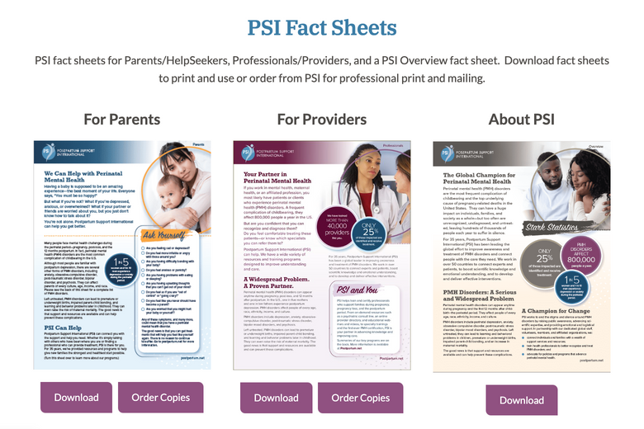

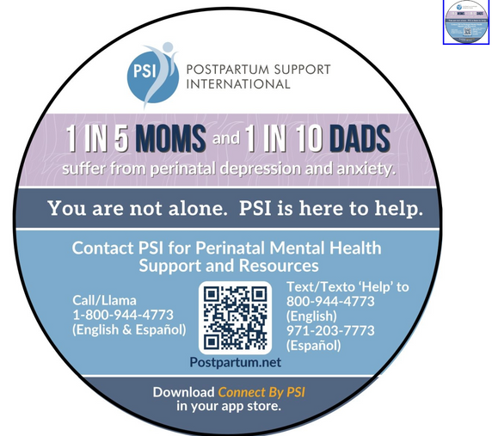
Postpartum Support International - Resources
Postpartum Support International has a number of resources that you may find helpful!
Including:
an online “Swag Store” where you can purchase official PSI helpline magnets here
Great educational resources - for parents, providers, and general population
Available in a number of languages!

Slide 22


Agenda
12:00-12:05 Welcome & PNQIN Announcements
12:05-12:45 Organization Presentation
12:45-12:50 PMHC Bundle Pearls
12:50-1:00 Discussion, Q&A
Organization Presentation
Kriti Lodha
Postpartum Support International - MA Chapter
Amy Colozzo
Postpartum Support International - MA Board Chair

Slide 23







The Perinatal-Neonatal Quality Improvement Network of Massachusetts
Help Support The Mental Health of New Families
Postpartum Support International of Massachusetts
October 15, 2024
12PM EST
Notes:
Kriti

Slide 24


Overview: Postpartum Support International (PSI)
PSI Vision
Every parent and family worldwide will have access to information, social support, and informed professional care to deal with mental health issues related to childbearing. PSI promotes this vision through advocacy and collaboration, and by educating and training the professional community and the public.
www.postpartum.net | 800.944.4773 | © 2023 PSI
Notes:
Kriti

Slide 25

Introductions
Kriti Lodha (she/her)
Maternal Mental Health Advocate
PSI Massachusetts Board Member
PSI Peer Support Group Leader
Perinatal Psychosis Taskforce Member
PNQIN-MA Advisory Workgroup Member
Seasoned Marketing Executive
My Why: I was motivated to turn my pain into purpose after silently battling postpartum psychosis in the pandemic. I want to role model the importance of advocacy, representation & service for my 3 year old daughter Naina.
Get In Touch | LinkedIn
www.postpartum.net | 800.944.4773 | © 2023 PSI
Notes:
Kriti

Slide 26

Introductions
Amy Colozzo (she/her)
LICSW, PMH-C
Private practice owner
PSI-MA Board Co-Chair
PSI Local Support Coordinator
My Why: My own experience with perinatal anxiety and postpartum depression after the birth of my 2nd daughter prompted me to educate myself on how to better help other families not have to suffer alone.
Get In Touch | amy@colozzolicsw.com
www.postpartum.net | 800.944.4773 | © 2023 PSI
Notes:
Amy

Slide 27
Perinatal Mental Health Disorders 101
www.postpartum.net | 800.944.4773 | © 2023 PSI
Notes:
Amy

Slide 28

THE ‘BABY BLUES’
About 80% of new mothers experience the baby blues in the first 2 weeks after the baby arrives.
With support, rest, and good nutrition, the baby blues will naturally go away in 2 weeks after the birth of the baby.
If the challenges began during pregnancy, last longer than 2 weeks, or are making it hard to function, don’t wait to seek help!
www.postpartum.net | 800.944.4773 | © 2023 PSI
Notes:
Amy

Slide 29


STATISTICS
1 in 5-7 mothers experience serious depression (PPD) or anxiety (PPA) during pregnancy or postpartum.
1 in 10 fathers experience depression before or after the birth of their child.
1-2 of 1,000 might have a serious condition called postpartum psychosis (PPP).
Some populations experience higher prevalences: queer, BIPOC parents, military
www.postpartum.net | 800.944.4773 | © 2023 PSI
Notes:
Amy

Slide 30
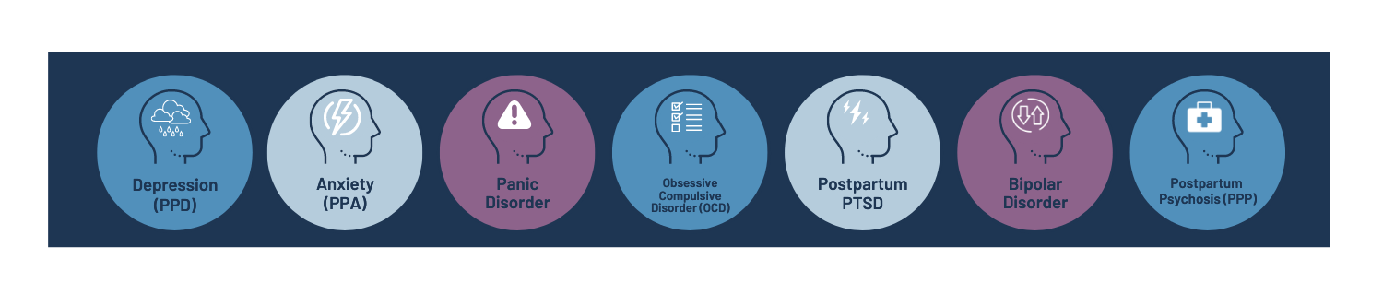
PMHDs – Perinatal Mental Health Disorders
Postpartum Depression (PPD)
Postpartum Anxiety (PPA)
Panic Disorder
Obsessive-Compulsive Disorder (OCD)
Postpartum Post-Traumatic Stress Disorder (PTSD)
Bipolar Disorder
Perinatal Psychosis (PPP)
www.postpartum.net | 800.944.4773 | © 2023 PSI
Notes:
Amy

Slide 31
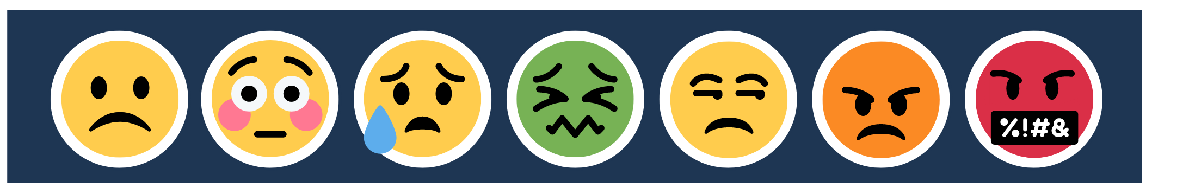
SYMPTOMS
Feelings of guilt, shame or hopelessness
Feelings of anger, irritability and rage
Lack of interest in or difficulty bonding with baby
Disturbances in appetite and/or sleep
Crying and sadness, constant worry or racing thoughts
Having scary and unwanted thoughts
Lack of interest or pleasure in things you used to enjoy
Dizziness, hot flashes, and/or nausea
Possible thoughts of harming yourself or others
www.postpartum.net | 800.944.4773 | © 2023 PSI
Notes:
Amy

Slide 32

WHO IS IMPACTED?
Mothers,
Fathers,
Same-sex partners,
Adoptive parents,
Grandparents,
Caregivers.
It’s important to check on ALL family members.
Any of the above can experience Perinatal Mental Health Conditions!
www.postpartum.net | 800.944.4773 | © 2023 PSI
Notes:
Amy

Slide 33

RISK FACTORS
Personal or family history of depression, anxiety, or PPD
Pregnancy or delivery complications
Miscarriage or infant loss
Baby in the NICU
Fertility challenges
Baby feeding complications
Abrupt discontinuation of lactation
www.postpartum.net | 800.944.4773 | © 2023 PSI
Notes:
Amy

Slide 34

RISK FACTORS continued…
Sensitive to hormonal changes
Having twins or multiples
Lack of support from family or friends
Financial stress or poverty
Marital or relationship stress
Loss of a loved one, a recent move, or sudden job loss
Away from home country
Perfectionism, unrealistic expectations
www.postpartum.net | 800.944.4773 | © 2023 PSI
Notes:
Amy

Slide 35

HELPFUL PRACTICES
Support from family, friends or a postpartum doula
Help with baby and other children
Increased self-care
Getting adequate sleep
Eating a healthy diet
Moving some each day
Time with spouse/partner/supportive friends
Spiritual practice and support
Don’t be afraid to ask for help
www.postpartum.net | 800.944.4773 | © 2023 PSI
Notes:
Amy

Slide 36

TREATMENT OPTIONS
PMHD-focused support groups
New Parent Education groups/classes
Counseling or mental health therapy
Medication
www.postpartum.net | 800.944.4773 | © 2023 PSI
Notes:
Amy

Slide 37
PSI Resources
www.postpartum.net | 800.944.4773 | © 2023 PSI
Notes:
Amy

Slide 38

EMERGENCY RESOURCES
Maternal Mental Health Hotline
833.852.6262
Text or call (24/7)
National Suicide Prevention Lifeline
Dial 988
suicidepreventionlifeline.org
Crisis Text Hotline (24/7)
Text HOME to 741741
Domestic Violence Hotline
800.799.7233
Text START to 88788
www.postpartum.net | 800.944.4773 | © 2023 PSI
Notes:
Amy

Slide 39

PSI RESOURCES FOR PROVIDERS
For Clinical Practice
Perinatal Psychiatric Consult Line: for medical providers unsure about prescribing psychiatric medication to pregnant, postpartum, pre-conception, and post-loss patients. 877-499-4773
PSI Directory: free directory of perinatal mental health specialists. (www.psidirectory.com)
Trainings and Annual Conference
Frontline Provider Training: Training that gives frontline providers the necessary skills to assess and support patients with perinatal mental health complications. (CMEs and CEs)
www.postpartum.net | 800.944.4773 | © 2023 PSI
Notes:
Amy
I’d actually like to be more specific with trainings—we have so many good ones: 2-day components of Care, advanced psychotherapy, advanced psychopharmacology, perinatal Grief and Loss, Paternal PMH, PMH 101 (FREE 90-min webinar) I realize that means another slide BGM
Laura Killgore added icons to the top and created a new slide bellow 08/10/23
8/18 JRP suggestion- can we reduce the words on this slide. Is it implied that this presentation is for information on PMHD and support - so we may not need to repeat this?
Also do we need to list trainings here if we also do on slide 15. (maybe move conference and Frontline to slide 15) if we move trainings from slide 13 to 15., then we can combine 13 and 14.
Consultation for medical professionals who have questions about prescribing psychiatric medication 877.499.4773
Provider directory: good
PMHD Training (via webinar or onsite locations) that equips frontline providers with the necessary skills to assess and support patients (CMEs and CEs)

Slide 40

FOR PROVIDERS
Professional Development & Engagement
Perinatal Mental Health Certification (PMH-C): creates professional education and evaluation and a standardization of training and experience.
Perinatal Mental Health Alliance for People of Color (PMHA-POC): a program within PSI, aims to fill a gap in support services for professionals and communities of color around PMHDs.
Membership: PSI members around the world receive benefits including online learning/networking groups, discounts on trainings, and more.
PSI State Chapters: further the mission of PSI on a statewide level.
www.postpartum.net | 800.944.4773 | © 2023 PSI
Notes:
Amy
Laura Killgore added icons to the top 08/10/23
if we move trainings from lisde 13 to 15., then we can combine 13 and 14.

Slide 41

PSI RESOURCES FOR PROVIDERS
PSI Trainings:
2-day Components of Care
Advanced Psychotherapy
Advanced Psychopharmacology
Perinatal Grief and Loss
Paternal PMH
PMH 101 (FREE 90-min webinar)
www.postpartum.net | 800.944.4773 | © 2023 PSI
Notes:
Amy

Slide 42

PSI RESOURCES FOR PARENTS
PSI Website: Support, education, and local resources (www.postpartum.net).
PSI HelpLine:
English, call or text 'HELP' to 800-944-4773
Spanish, call 800-944-4773 or text 971-203-7773
Find Local Help: PSI Support Coordinators connect families to local resources and providers.
Provider Directory: search for trained perinatal mental health providers. (www.psidirectory.com)
Online Support Groups: 50+ free support groups focused on a wide range of specialized perinatal needs.
Peer Mentor Program: Parents are paired with a fully recovered survivor from a PMHD for support.
www.postpartum.net | 800.944.4773 | © 2023 PSI
Notes:
Kriti

Slide 43



PSI RESOURCES FOR PARENTS
Chat with an Expert: Connect with other parents and talk with a PSI mental health expert about resources, symptoms, and treatment options.
first Mondays for Dads,
every Wednesday for Moms
PSI on Smart Patients Forum: For women affected by PMHDs to share, interact, and learn from peers in a safe, supportive environment.
Perinatal Mental Health Discussion Tool: For parents to identify PMHD symptoms to discuss with their provider.
Social Media:
@postpartumsupportinternational
@postpartumsupportinternational
@postpartumhelp
@postpartumhelp
www.postpartum.net | 800.944.4773 | © 2023 PSI
Notes:
Kriti

Slide 44
Lessons from my lived experience
www.postpartum.net | 800.944.4773 | © 2023 PSI
Notes:
Kriti

Slide 45
Overview: Perinatal Psychosis (PPP)
PPP is a medical emergency. Symptoms include:
Delusions or strange beliefs
Hallucinations (seeing or hearing things that aren’t there)
Feeling very irritated
Hyperactivity
Severe depression or flat affect
Decreased need for or inability to sleep
Paranoia and suspiciousness
Rapid mood swings
Difficulty communicating at times
Timely treatment can prevent trauma or tragedy.
Learn more about PPP here.
www.postpartum.net | 800.944.4773 | © 2023 PSI
Notes:
Kriti

Slide 46
My Patient Journey: No One PPP Experience Looks the Same
Prior to Pregnancy
Pregnancy
2 Weeks Postpartum
1 Month Postpartum
1 Year Postpartum
No prior history of mental illness
No history of substance abuse
No known risk factors for PPP
Pregnancy risk factors: PCOS + preeclampsia (genetic history)
No mental health challenges
COVID-19 isolation (pre-vaccines)
Traumatic Birth
Traumatic Feeding
Onset of manic / psychotic episode(s)
Patient call to 911
Partner + OB Admit to ER (48 hours)
Transferred to inpatient (8 days)
Outpatient treatment in mother-baby unit (10 days)
Perinatal psychiatrist (confirmed diagnosis)
Perinatal therapist
Individualized treatment plan
Screened @ 6 Wk OB
Tapered off all medications
PTSD after PPP
Continued talk therapy
Learn more about Kriti’s story here.
www.postpartum.net | 800.944.4773 | © 2023 PSI
Notes:
Kriti

Slide 47
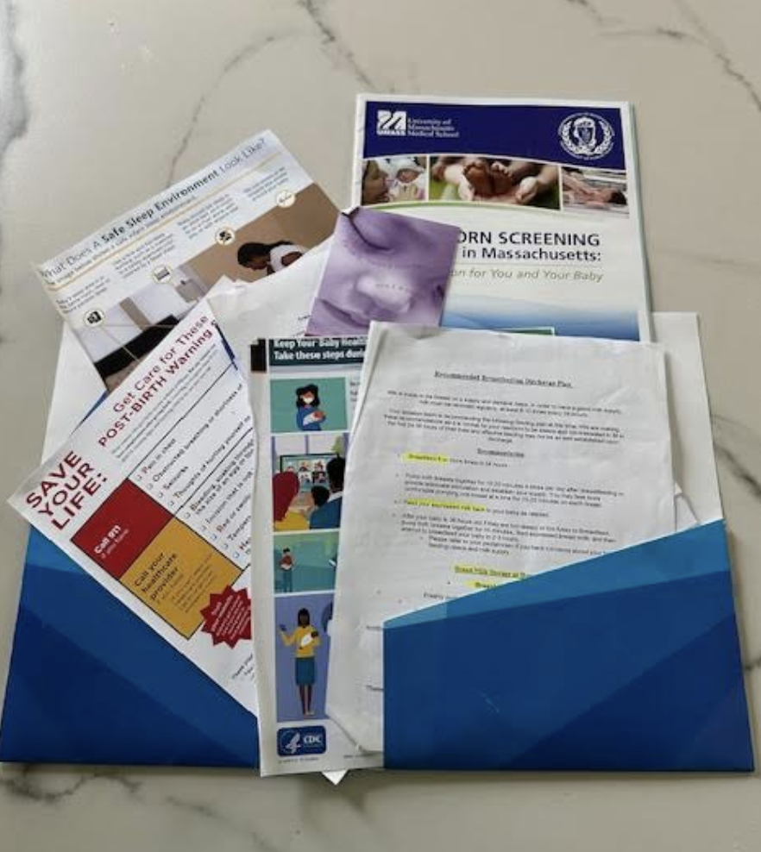
#1: Create a mental health plan early, not just a birth plan
My Hospital Discharge Packet: “After Your Delivery, What You Need to Know”
30+ pages of resources around breastfeeding, newborn sleep, postpartum hemorrhage, COVID-19 guidance, etc.
Included one-pager on perinatal mental health disorders, including PSI Massachusetts as a resource - which me & my partner never had a chance to review
www.postpartum.net | 800.944.4773 | © 2023 PSI
Notes:
Kriti

Slide 48
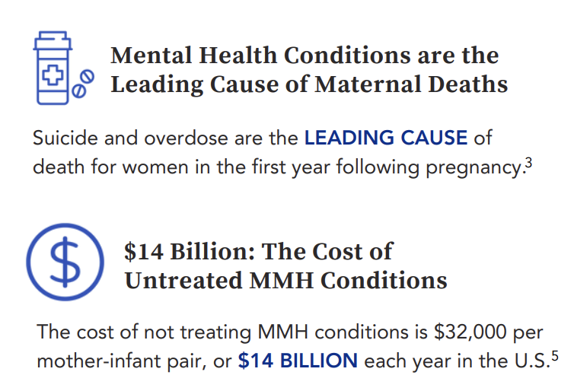
#2: Educate all frontline caregivers: knowledge is power
Too much onus is placed on birthing people to take action and advocate for themselves.
We must empower all caregivers for timely treatment of perinatal mental health disorders:
Partners
OBs
Psychiatrists
Pediatricians
NPs
Midwives
Doulas
ER Doctors
Source: Maternal Mental Health Fact Sheet: MMHLA
www.postpartum.net | 800.944.4773 | © 2023 PSI
Notes:
Kriti

Slide 49
#3: Leverage lived experience for expertise, not just stories
Representation matters. Leverage lived experience to deliver improved patient experience and outcomes.
This is especially important for historically marginalized or underrepresented populations.
Lived
Experience
Professional
Expertise
The Opportunity
www.postpartum.net | 800.944.4773 | © 2023 PSI
Notes:
Kriti

Slide 50
Closing Remarks
www.postpartum.net | 800.944.4773 | © 2023 PSI
Notes:
Amy

Slide 51

How to Stay Connected with PSI
Postpartum Support International of Massachusetts (PSI-MA)
Learn more about our chapter here
Get in touch: PSIofMass@gmail.com
Follow PSI-MA on Instagram
Become a member of PSI-MA
Attend PSI Team Boston Climb Event on October 27th
www.postpartum.net | 800.944.4773 | © 2023 PSI
Notes:
Amy

Slide 52

You are not alone.
You are not to blame.
With help, you will be well.
www.postpartum.net | 800.944.4773 | © 2023 PSI
Notes:
Amy

Slide 53
Q&A
www.postpartum.net | 800.944.4773 | © 2023 PSI
Notes:
Amy

Slide 54

Agenda
12:00-12:05 Welcome & PNQIN Announcements
12:05-12:45 Organization Presentation
12:45-12:50 PMHC Bundle Pearls
12:50-1:00 Discussion, Q&A
Perinatal Mental Health Conditions Bundle Pearls: Postpartum Psychosis
Tiffany Moore Simas, MD
PNQIN Bundle Lead

Slide 55

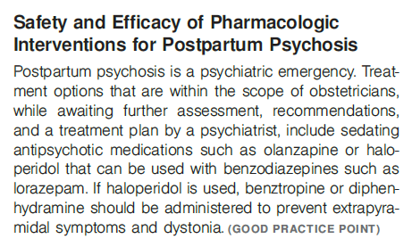
Perinatal Mental Health Conditions Bundle Pearls: Postpartum Psychosis – Psychiatric Emergency
1-2/1,000 perinatal individuals
24 hours – 3 wks postpartum
> 70% bipolar disorder
Psychiatric assessment incl risk of harm to self, infant, and others
Psychiatric hospitalization
1:1 continuous observation +/- newborn sep
Stabilize while awaiting eval
1st line = Sedative antipsychotic
Haloperidol* or olanzapine
with short-term benzo use
*Prevent extrapyramidal side effects and dystonia (e.g. Benadryl, benztropine)
Ron Iverson, Kali Vitek

Slide 56
Agenda
12:00-12:05 Welcome & PNQIN Announcements
12:05-12:45 Organization Presentation
12:45-12:50 PMHC Bundle Pearls
12:50-1:00 Discussion, Q&A
Any Questions?

Slide 57

Thanks for joining, see you on 11/19!
Have questions?
Email PNQINAdmin@pnqinma.org!

